Slide 1
SSZG518: Database design and Applications Ms. Uma Maheswari

Slide 2
Session 9
INDEXING

Slide 3
LEARNING OUTCOME
Types of Indexes; Sparse and Dense indexing
Multilevel indexes
Dynamic indexing with B-Trees and B+ Trees
REFER: T1-Chapter 14
Sections: 14.1 – 14.5

Slide 4
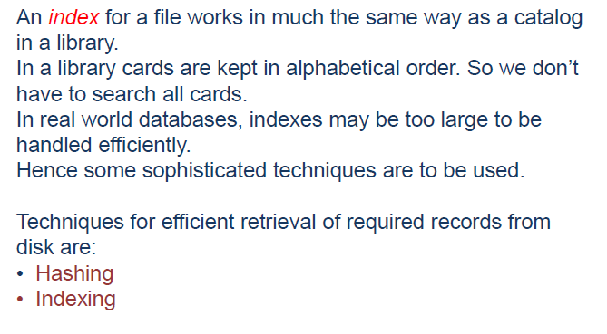
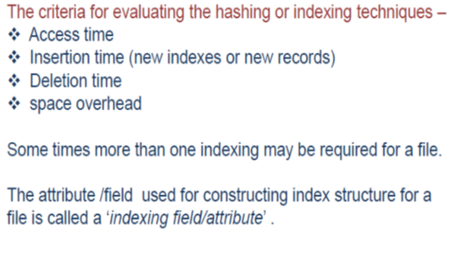
Introduction to Indexing

Slide 5
Why and what is Indexing??
Indexing is a way to optimize performance of a database by minimizing the number of disk accesses required when a query is processed.
An index or database index is a data structure which is used to quickly locate and access the data in a database table.
When a database is very huge, even a smallest transaction will take time to perform the action. In order to reduce the time spent in transactions, Indexes are used. Indexes are similar to book catalogues in library or even like an index in a book..
Therefore ….
An index is a small table having only two columns. The first column contains a copy of the primary or candidate key of a table and the second column contains a set of pointers holding the address of the disk block where that particular key value can be found.

Slide 6
Question?
Qn: Imagine we have a student table with thousands of records, each of which is 10 bytes long. Imagine their IDs start from 1 2, 3… and goes on. And we have to search student with ID 678.
Sol: In a normal database with no index, it searches the disk block from the beginning till it reaches 678. So the DBMS will reach this record after reading 677*10 = 6770 bytes.
if we have index on ID column, then the address of the location will be stored as each record as (1,200), (2, 201)… (678, 879) and so on. One can imagine it as a smaller table with index column and address column. Now if we want to search record with ID 678, then it will search using indexes. i.e.; here it will traverse only 677*2 = 1354 bytes

Slide 7
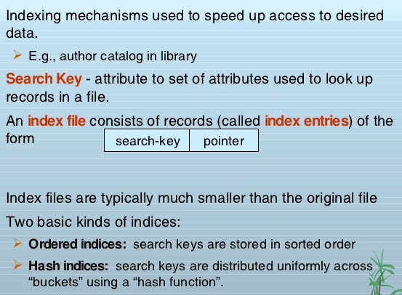
Indexing introduction

Slide 8

Access Types: e.g. value based search, range access, etc.
Access Time: Time to find particular data element or set of elements.
Insertion Time: Time taken to find the appropriate space and insert a new data time.
Deletion Time: Time taken to find an item and delete it as well as update the index structure.
Space Overhead: Additional space required by the index.
NOTE: Hashing or indexing two techniques either of which is used depending on database application.

Slide 9
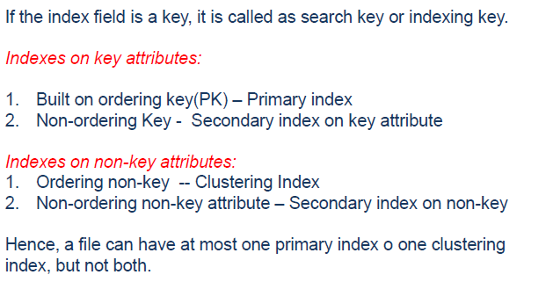
What is search Key?

Slide 10
Indexing Methods
Indexing is defined based on its indexing attributes. Indexing can be of the following types −
Primary Index − Primary index is defined on an ordered data file. The data file is ordered on a key field. The key field is generally the primary key of the relation.
Secondary Index − Secondary index may be generated from a field which is a candidate key and has a unique value in every record, or a non-key with duplicate values.
Clustering Index − Clustering index is defined on an ordered data file. The data file is ordered on a non-key field.
Ordered Indexing is of two types −
Dense Index
Sparse Index

Slide 11
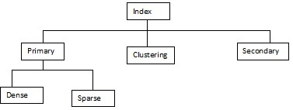
Indexing Methods

Slide 12
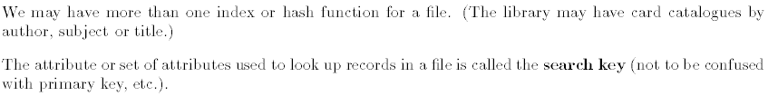
Indexing introduction

Slide 13
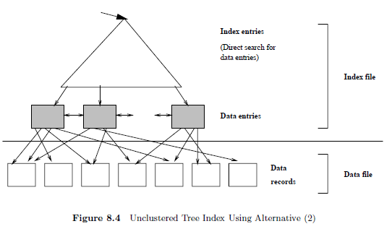
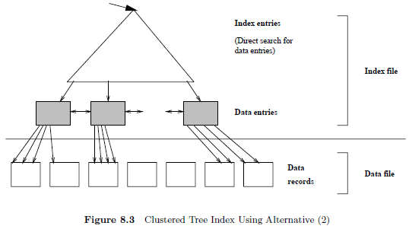
Clustered and Non clustered

Slide 14
Clustered Indexing
Clustering index is defined on an ordered data file.
The data file is ordered on a non-key field.
In some cases, the index is created on non-primary key columns which may not be unique for each record.
In such cases, in order to identify the records faster, we will group two or more columns together to get the unique values and create index out of them. This method is known as clustering index.
Basically, records with similar characteristics are grouped together and indexes are created for these groups.

Slide 15
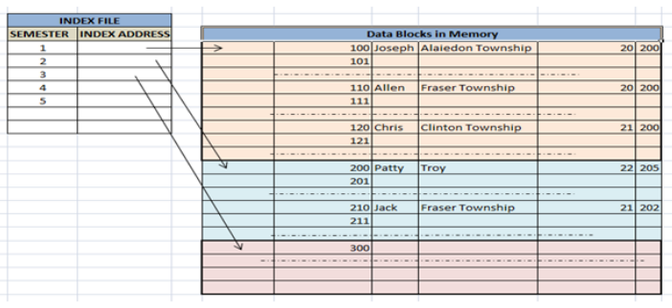
Example of clustered index
For example, students studying in each semester are grouped together. i.e. 1st Semester students, 2nd semester students, 3rd semester students etc are grouped.

Slide 16
Non­-Clustered Indexing
A non clustered index just tells us where the data lies, i.e. it gives us a list of virtual pointers or references to the location where the data is actually stored.
Data is not physically stored in the order of the index. Instead , data is present in leaf nodes.
For eg. the contents page of a book.
Each entry gives us the page number or location of the information stored. The actual data here(information on each page of book) is not organised but we have an ordered reference(contents page) to where the data points actually lie.
It requires more time as compared to clustered index because some amount of extra work is done in order to extract the data by further following the pointer. In case of clustered index, data is directly present in front of the index.

Slide 17
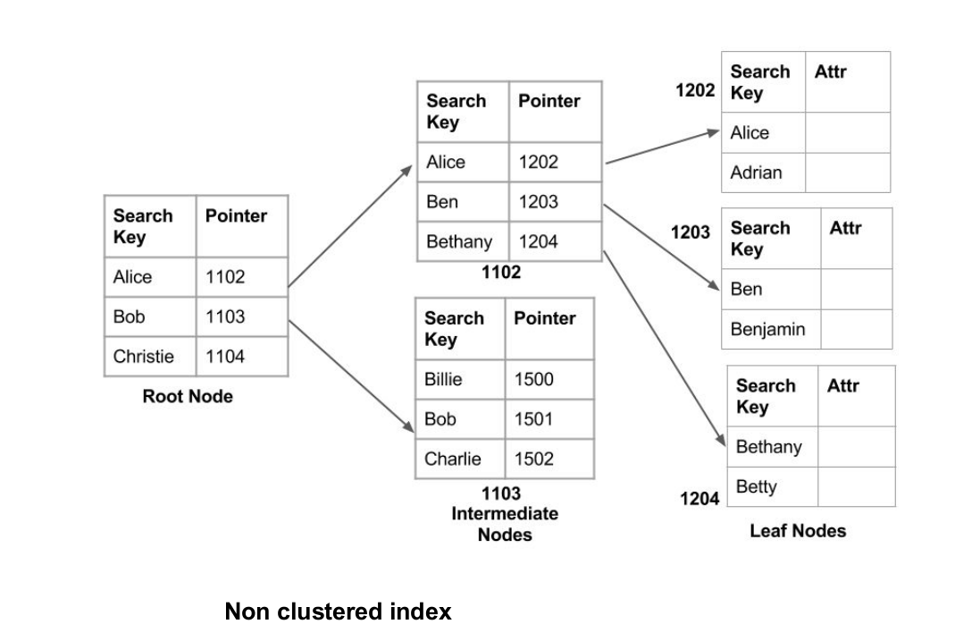
Non­-Clustered Indexing : example

Slide 18
How data is stored on disk?

Slide 19
Ordered Indices
The indices are usually sorted so that the searching is faster. The indices which are sorted are known as ordered indices.
If the search key of any index specifies same order as the sequential order of the file, it is known as primary index or clustering index. Note: The search key of a primary index is usually the primary key, but it is not necessarily so.
If the search key of any index specifies an order different from the sequential order of the file, it is called the secondary index or non-clustering index.

Slide 20
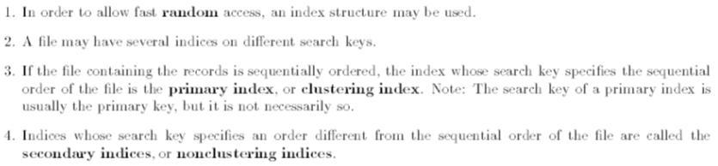
What is an ordered Indices?
Indices can be SINGLE LEVEL or MULTILEVEL .
We may need to have a set of records satisfying the search key , SO which is better/faster cluster or non cluster?

Slide 21
SINGLE LEVEL INDEXES
For a file with a given record structure consisting of several fields (or attributes), an index access structure is usually defined on a single field of a file, called an indexing field (or indexing attribute).
The index typically stores each value of the index field along with a list of pointers to all disk blocks that contain records with that field value.
The values in the index are ordered so that we can do a binary search on the index.
If both the data file and the index file are ordered, and since the index file is typically much smaller than the data file, searching the index using a binary search is a better option.

Slide 22
Single level Indices

Slide 23
Indexes

Slide 24
Primary Index
If the index is created on the primary key of the table then it is called as Primary Indexing.
Since these primary keys are unique to each record and it has 1:1 relation between the records, it is much easier to fetch the record using it.
Also, these primary key are kept in sorted form which helps in performance of the transactions.
The primary indexing is of two types – Dense Index and Sparse Index.

Slide 25
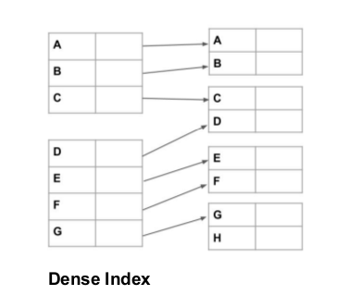
Dense Index
For every search key value in the data file, there is an index record.
This record contains the search key and also a reference to the first data record with that search key value.

Slide 26
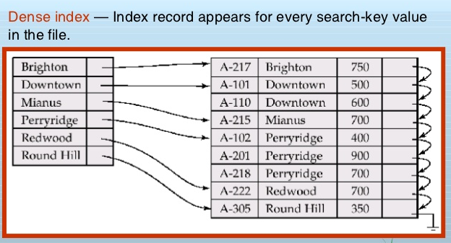
Dense Index : example

Slide 27
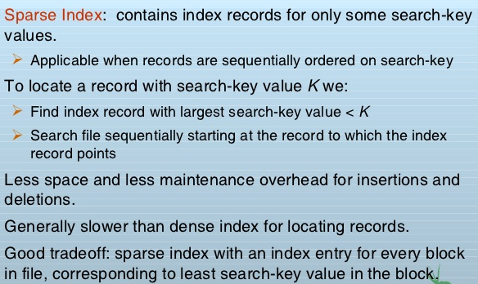
Sparse Index

Slide 28
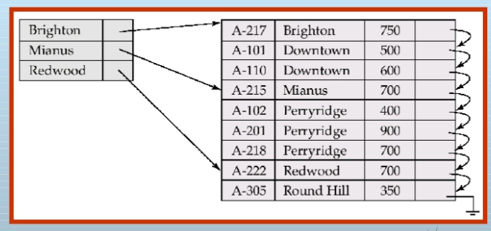
Sparse Index : example
QUESTION

Slide 29
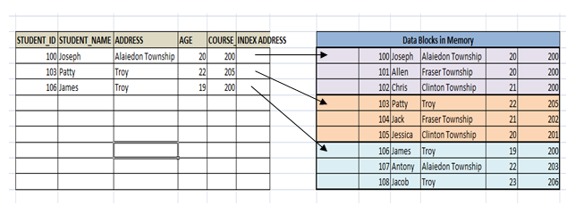
Sparse Index : example

Slide 30
Primary index
A primary index is an ordered file whose records are of fixed length with two fields, and it acts like an access structure to efficiently search for and access the data records in a data file.
The first field is of the same data type as the ordering key field—called the primary key—of the data file, and the second field is a pointer to a disk block (a block address).
There is one index entry (or index record) in the index file for each block in the data file.
Each index entry has the value of the primary key field for the first record in a block and a pointer to that block as its two field values.
We will refer to the two field values of index entry i as <K(i), P(i)>.

Slide 31
How it works ?
we have not stored the indexes for all the records, instead only for 3 records indexes are stored.
Now if we have to search a student with ID 102, then the address for the ID less than or equal to 102 is searched – which returns the address of ID 100.
This address location is then fetched linearly till we get the records for 102. Hence it makes the searching faster and also reduces the storage space for indexes.

Slide 32
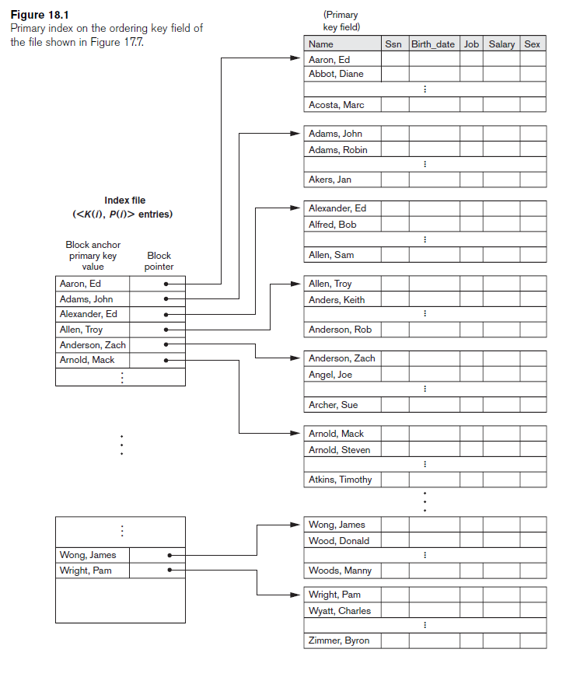
Primary index

Slide 33
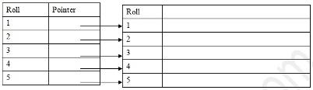
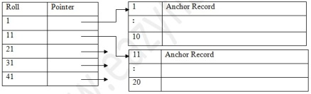
Primary Index
Primary Index In primary index, there is a one-to-one relationship between the entries in the index table and the records in the main table. Primary index can be of two types:
Dense primary index: the number of entries in the index table is the same as the number of entries in the main table. In other words, each and every record in the main table has an entry in the index.
Sparse or Non-Dense Primary Index: For large tables the Dense Primary Index itself begins to grow in size. To keep the size of the index smaller, instead of pointing to each and every record in the main table, the index points to the records in the main table in a gap. See the following example

Slide 34
Example

Slide 35
Example contd..
Note: Primary Index is created automatically when a table has a primary key in it.

Slide 36
How does the Primary Index file get updated ?

Slide 37
Primary Index

Slide 38
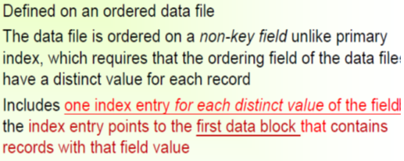
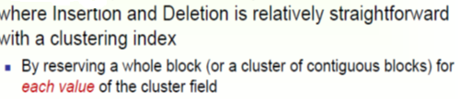
Clustering index
EXAMPLE :
when asked to create an index on a non-unique key, such as Dept-id.
There could be several employees in each department.
Here we use a clustering index, where all employees belonging to the same Dept-id are considered to be within a single cluster, and the index pointers point to the cluster as a whole.

Slide 39
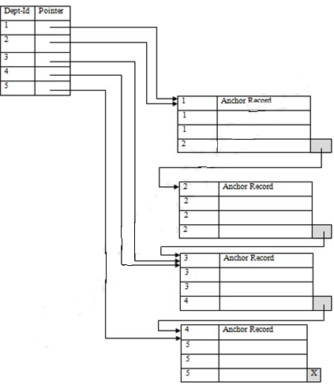
Clustered Index
The disk blocks contain a fixed number of records (in this case 4 each).
The index contains entries for 5 separate departments.
The pointers of these entries point to the anchor record of the block where the first of the Dept-id in the cluster can be found.
The blocks themselves may point to the anchor record of the next block in case a cluster overflows a block size. This can be done using a special pointer at the end of each block (comparable to the next pointer of the linked list organization).

Slide 40
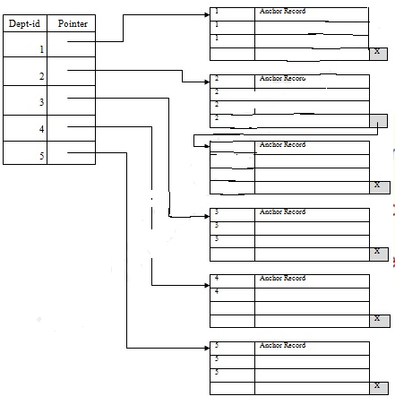
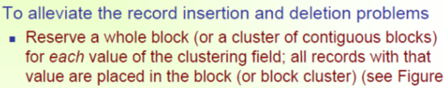
Clustering Index
A better scheme could be to use separate disk blocks for separate clusters.

Slide 41
Secondary Index

Slide 42
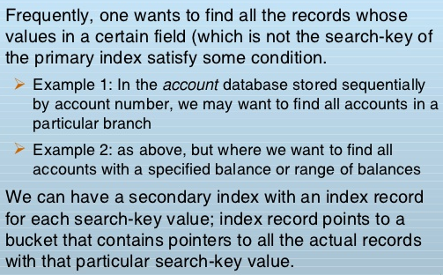
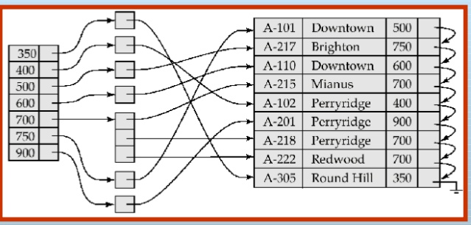

Secondary Indexes

Slide 43
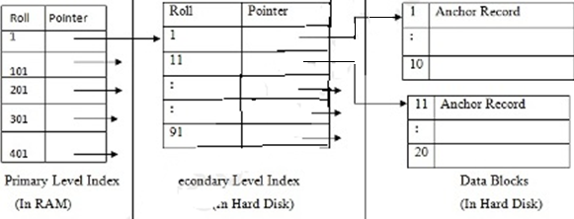
Secondary Indexes
While creating the index, generally the index table is kept in the primary memory (RAM) and the main table, because of its size is kept in the secondary memory (Hard Disk). Theoretically, a table may contain millions of records (like the telephone directory of a large city), for which even a sparse index becomes so large in size that we cannot keep it in the primary memory. And if we cannot keep the index in the primary memory, then we lose the advantage of the speed of access.
For very large table, it is better to organize the index in multiple levels. See the following example.
the primary level index, (created with a gap of 100 records, and thereby smaller in size), is kept in the RAM for quick reference. If you need to find out the record of roll 14 now, the index is first searched to find out the highest entry which is smaller than or equal to 14. We have 1. The adjoining pointer leads us to the anchor record of the corresponding secondary level index, where another similar search is conducted. This finally leads us to the actual data block whose anchor record is roll 11. We now come to roll 11 where a short sequential search is made to find out roll 14.

Slide 44
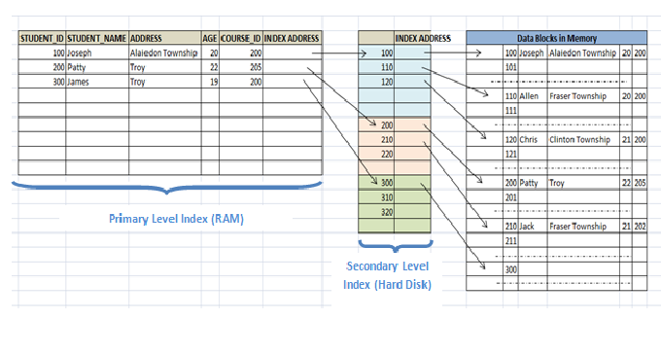
Secondary Indexes

Slide 45
Secondary Indexes
For example, if it has to search 111 in the above diagram example, it will search the max (111) <= 111 in the first level index. It will get 100 at this level.
Then in the secondary index level, again it does max (111) <= 111, and gets 110.
Now it goes to data block with address 110 and starts searching each record till it gets 111. This is how a search is done in this method. Inserting/deleting/updating is also done in same manner.

Slide 46
Secondary Indexes
Examples
Often one wants to find all records whose values in a certain
field (which is not the search key of the primary index) satisfy
some condition
Example 1: In the EMPLOYEE database, records are stored
sequentially by EmpNo, we want to find employees working
in a particular department.
Example 2: as above, but we want to find all employees
with a specified salary or range of salary.
One can specify a secondary index with an index entry for
each search key value; index entry points to a bucket, which
contains pointers to all the actual records with that particular
search key.

Slide 47
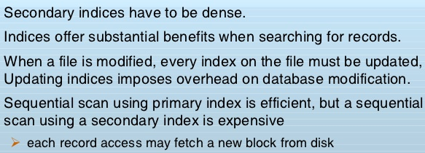
Primary VS secondary indices

Slide 49
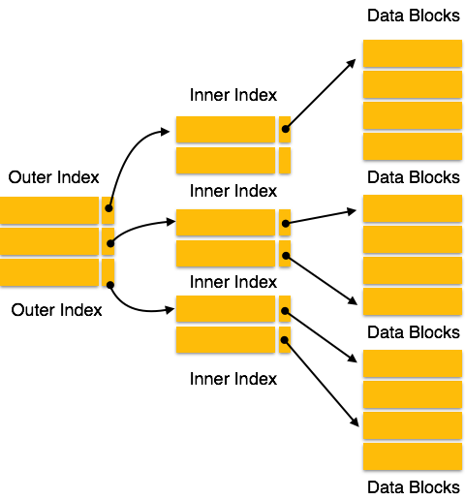
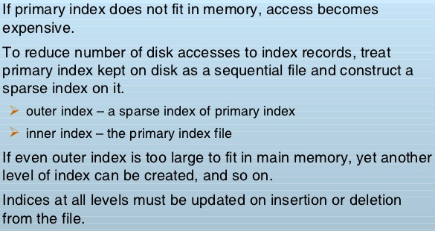
Multilevel Index
Multi-level Index helps in breaking down the index into several smaller indices in order to make the outermost level so small that it can be saved in a single disk block, which can easily be accommodated anywhere in the main memory

Slide 50
Multilevel Index

Slide 51
Multilevel Index

Slide 52
Multilevel Index and soln to its limitations

Slide 53
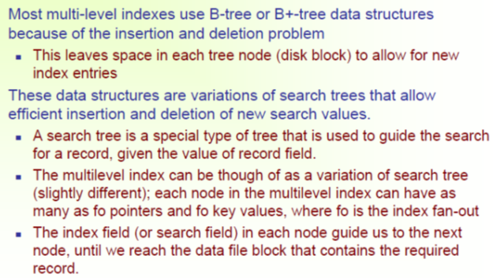

Slide 55
B-TREES

Slide 56
B tree

Slide 57
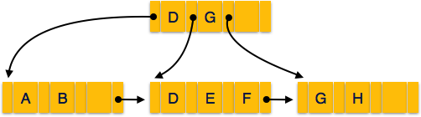
B+ tree
A B⁺ tree is a balanced binary search tree that follows a multi-level index format. The leaf nodes of a B⁺ tree denote actual data pointers. B⁺ tree ensures that all leaf nodes remain at the same height, thus balanced. Additionally, the leaf nodes are linked using a link list; therefore, a B⁺ tree can support random access as well as sequential access.
Structure of B⁺ Tree
Every leaf node is at equal distance from the root node. A B⁺ tree is of the order n where n is fixed for every B⁺ tree
Internal nodes −
Internal (non-leaf) nodes contain at least ⌈n/2⌉ pointers, except the root node.
At most, an internal node can contain n pointers.
Leaf nodes −
Leaf nodes contain at least ⌈n/2⌉ record pointers and ⌈n/2⌉ key values.
At most, a leaf node can contain n record pointers and n key values.
Every leaf node contains one block pointer P to point to next leaf node and forms a linked list.

Slide 58
B⁺ Tree
B⁺ Tree Insertion
B⁺ trees are filled from bottom and each entry is done at the leaf node.
If a leaf node overflows −
Split node into two parts.
Partition at i = ⌊(m+1)_{/2}⌋.
First i entries are stored in one node.
Rest of the entries (i+1 onwards) are moved to a new node.
i^{th} key is duplicated at the parent of the leaf.
If a non-leaf node overflows −
Split node into two parts.
Partition the node at i = ⌈(m+1)_{/2}⌉.
Entries up to i are kept in one node.
Rest of the entries are moved to a new node.
B⁺ Tree Deletion
B⁺ tree entries are deleted at the leaf nodes.
The target entry is searched and deleted.
If it is an internal node, delete and replace with the entry from the left position.
After deletion, underflow is tested,
If underflow occurs, distribute the entries from the nodes left to it.
If distribution is not possible from left, then
Distribute from the nodes right to it.
If distribution is not possible from left or from right, then Merge the node with left and right to it.

Slide 59
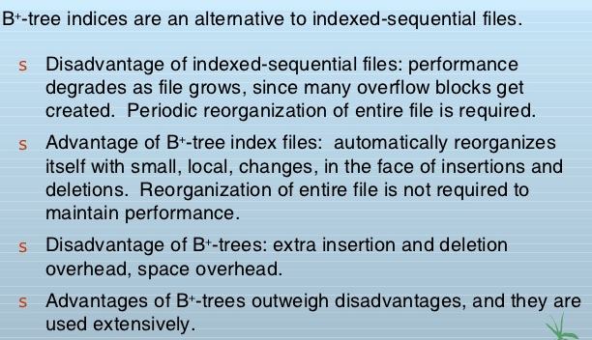
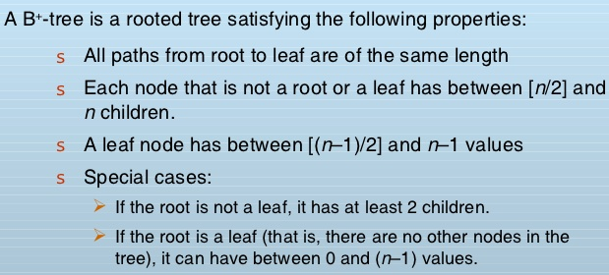
B+ tree Index files

Slide 60
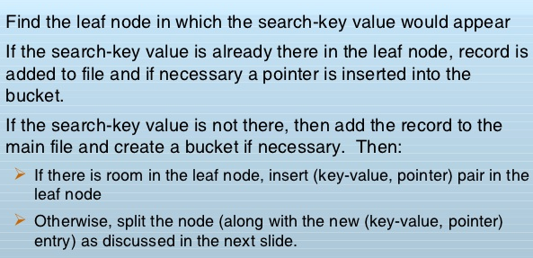
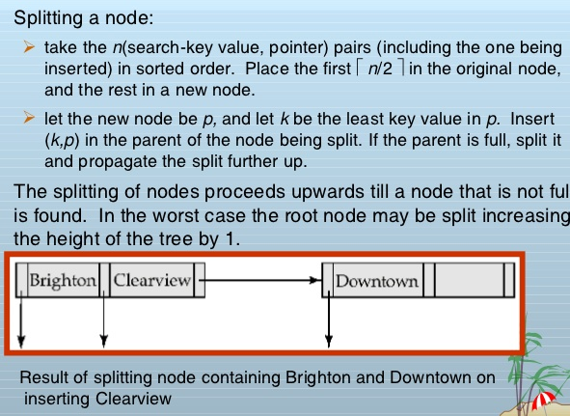

Slide 61
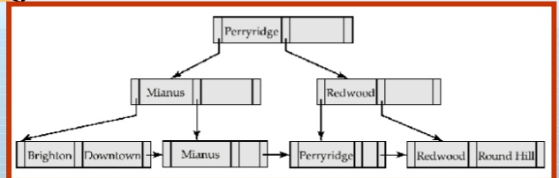
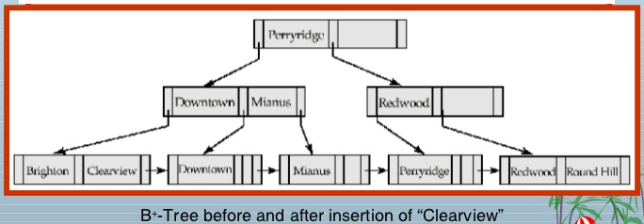
B+trees Insertion

Slide 62
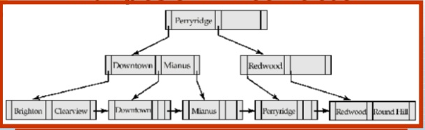
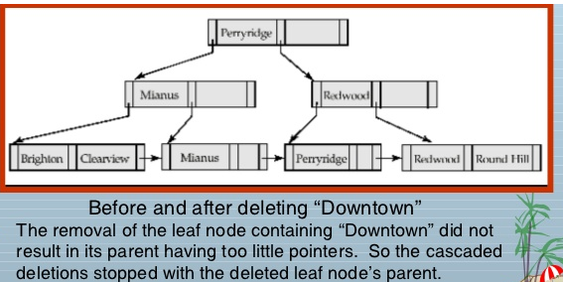

Slide 63
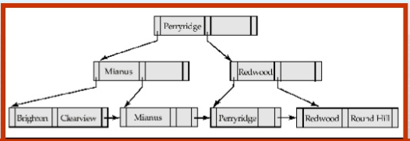
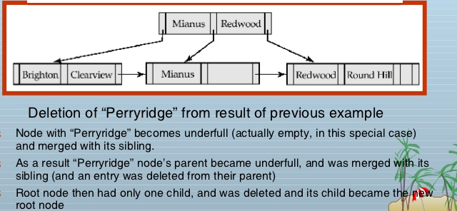

Slide 64
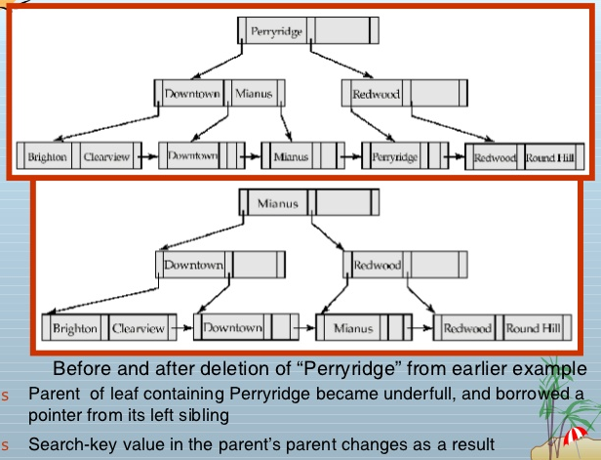

Slide 65
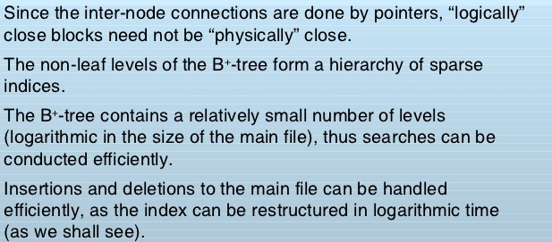
B tree

Slide 66

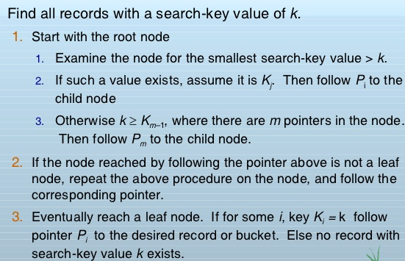
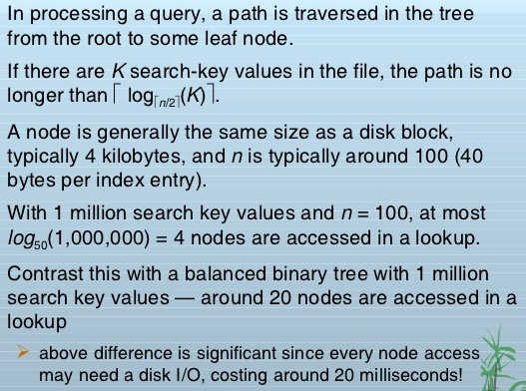
B+tree

Slide 67
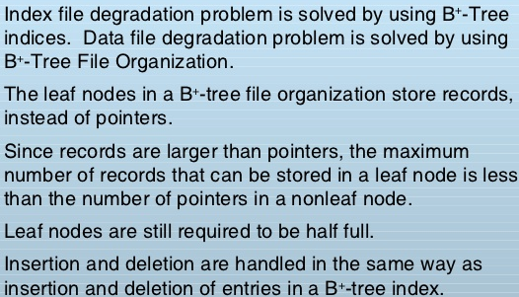
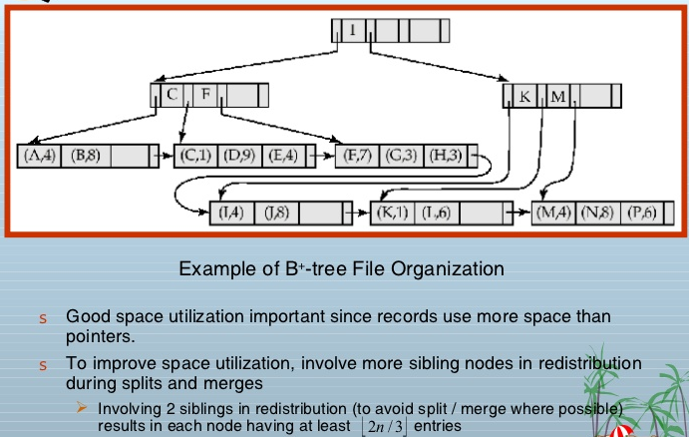

Slide 68

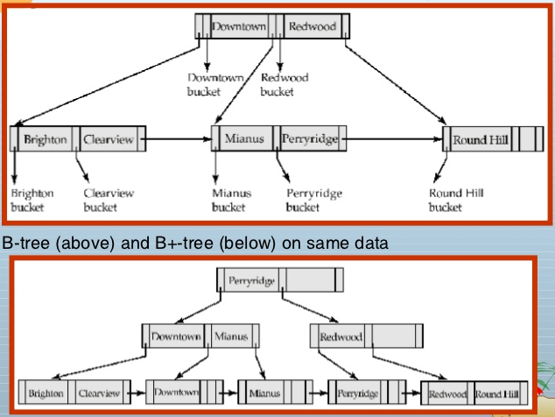


Slide 69

B Vs B+ trees

Slide 70


Multiple keys

Slide 71

Multiple keys

Slide 72

Multiple keys

Slide 73
Multiple keys

Slide 74
Some points:

Slide 75
Logical vs Physical Index

Slide 76


Slide 77
SQL CREATE INDEX Statement
Indexes are used to retrieve data from the database more quickly than otherwise.
The users cannot see the indexes, they are just used to speed up searches/queries.
Creates an index on a table. Duplicate values are allowed:
CREATE INDEX index_name ON table_name (column1, column2, ...);
Creates a unique index on a table. Duplicate values are not allowed:
CREATE UNIQUE INDEX index_name ON table_name (column1, column2, ...);
Note: Updating a table with indexes takes more time than updating a table without (because the indexes also need an update). So, only create indexes on columns that will be frequently searched against.

Slide 78
SQL CREATE INDEX Statement
E.g.,
The SQL statement below creates an index named "idx_lastname" on the "LastName" column in the "Persons" table:
CREATE INDEX idx_lastname ON Persons (LastName);
E.g.,
To create an index on a combination of columns, you can list the column names within the parentheses, separated by commas:
CREATE INDEX idx_pname ON Persons (LastName, FirstName);

Slide 79
MYSQL indexes
An index is a data structure such as B-Tree that improves the speed of data retrieval on a table at the cost of additional writes and storage to maintain it.
The query optimizer may use indexes to quickly locate data without having to scan every row in a table for a given query.
When you create a table with a primary key or unique key, MySQL automatically creates a special index named PRIMARY. This index is called the clustered index.
The PRIMARY index is special because the index itself is stored together with the data in the same table. The clustered index enforces the order of rows in the table.
Other indexes other than the PRIMARY index are called secondary indexes or non-clustered indexes.

Slide 80
MYSQL indexes
Syntax: CREATE INDEX index_name ON table_name (column_list)
By default, MySQL creates the B-Tree index if you don’t specify the index type.
The following shows the permissible index type based on the storage engine of the
table:
Storage Engine | Allowed Index Types
InnoDB | BTREE
MyISAM | BTREE
MEMORY/HEAP | HASH, BTREE

Slide 81
MYSQL indexes
EXPLAIN SELECT employeeNumber, lastName, firstName
FROM employees WHERE jobTitle = 'Sales Rep’;
MySQL just had to locate 17 rows from the jobTitle index as
indicated in the key column without scanning the whole table.
To show the indexes of a table
SHOW INDEXES FROM Tablenames;
E.g., SHOW INDEXES FROM employees;
The DROP INDEX statement is used to delete an index in a table.
DROP INDEX index_name ON table_name
[algorithm_option | lock_option];
E.g., DROP INDEX name ON leads;
ALGORITHM [=] {DEFAULT|INPLACE|COPY}
LOCK [=] {DEFAULT|NONE|SHARED|EXCLUSIVE}

Slide 82

MS SQL SERVER
SQL Server has two types of indexes: clustered index and non-clustered index. We will focus on the clustered index in this tutorial.
A clustered index stores data rows in a sorted structure based on its key values. Each table has only one clustered index because data rows can be only sorted in one order. The table that has a clustered index is called a clustered table.
The following picture illustrates the structure of a clustered index:

Slide 83
MS SQL SERVER
A clustered index organizes data using a special structured so-called B-tree (or balanced tree) which enables searches, inserts, updates and deletes in logarithmic amortized time.
In this structure, the top node of the B-tree is called the root node. The nodes at the bottom level are called the leaf nodes. Any index levels between the root and the leaf nodes are known as intermediate levels.
In the B-Tree, the root node and intermediate level nodes contain index pages that hold index rows. The leaf nodes contain the data pages of the underlying table. The pages in each level of the index are linked using another structure called a doubly-linked list.
When you create a table with a primary key, SQL Server automatically creates a
corresponding clustered index based on columns included in the primary key.

Slide 84
MS SQL SERVER
If you add a primary key constraint to an existing table that already has a clustered
index, SQL Server will enforce the primary key using a non-clustered index:
E.g.,
ALTER TABLE production.parts
ADD PRIMARY KEY(part_id);
SQL Server created a non-clustered index for the primary key./
Using create a clustered index statement:
CREATE CLUSTERED INDEX index_name
ON schema_name.table_name (column_list);
When executing the following statement, SQL Server traverses the index (Clustered index seek) to locate the row, which is faster than scanning the whole table.

Slide 85

MS SQL SERVER
A nonclustered index is a data structure that improves the speed of data retrieval from tables. Unlike a clustered index, a nonclustered index sorts and stores data separately from the data rows in the table. It is a copy of selected columns of data from a table with the links to the associated table.
Similar to a clustered index, a nonclustered index uses the B-tree structure to organize its data.
A table may have one or more nonclustered indexes and each non-clustered index may include one or more columns of the table.
The following picture illustrates the structure non-clustered index:

Slide 86
MS SQL SERVER
Besides storing the index key values, the leaf nodes also store row pointers to the data rows that contain the key values. These row pointers are also known as row locators.
If the underlying table is a clustered table, the row pointer is the clustered index key. In case the underlying table is a heap, the row pointer points to the row of the table.
To create a non clustered index:
CREATE [NONCLUSTERED] INDEX index_name
ON table_name(column_list);
or CREATE INDEX ON TABLENAME(cols);
Note: it is a best practice to place the columns that you often use to query data at the beginning of the column list of the index.

Slide 87
MS SQL SERVER
The sp_rename is a system stored procedure that allows you to rename any user-created object in the current database including table, index, and column.
EXEC sp_rename index_name, new_index_name, N'INDEX’;
A unique index may consist of one or many columns. If a unique index has one column, the values in this column will be unique. In case the unique index has multiple columns, the combination of values in these columns is unique.
Any attempt to insert or update data into the unique index key columns that causes the duplicate will result in an error.
CREATE UNIQUE INDEX index_name
ON table_name(column_list);
To drop index:
DROP INDEX [IF EXISTS]
index_name1 ON table_name1,
index_name2 ON table_name2,
...;

Slide 88
ORACLE
Oracle Database provides several indexing schemes, which provide complementary performance functionality. The indexes can be categorized as follows:
B-tree indexes : These indexes are the standard index type. They are excellent for primary key and highly-selective indexes. Used as concatenated indexes, B-tree indexes can retrieve data sorted by the indexed columns. B-tree indexes have the following subtypes:
Index-organized tables
An index-organized table differs from a heap-organized because the data is itself the index.
Reverse key indexes
In this type of index, the bytes of the index key are reversed, for example, 103 is stored as 301. The
reversal of bytes spreads out inserts into the index over many blocks.
Descending indexes
This type of index stores data on a particular column or columns in descending order.
B-tree cluster indexes
This type of index is used to index a table cluster key. Instead of pointing to a row, the key points to the
block that contains rows related to the cluster key.

Slide 89
ORACLE
Bitmap and bitmap join indexes
In a bitmap index, an index entry uses a bitmap to point to multiple rows. In contrast, a B-tree index entry points to a single row. A bitmap join index is a bitmap index for the join of two or more tables.
Function-based indexes
This type of index includes columns that are either transformed by a function, such as the UPPER function, or included in an expression. B-tree or bitmap indexes can be function-based..
Application domain indexes
This type of index is created by a user for data in an application-specific domain. The physical index need not use a traditional index structure and can be stored either in the Oracle database as tables or externally as a file.

Slide 90
ORACLE
To create an index :
CREATE [UNIQUE] INDEX index_name
ON table_name (column1, column2, ... column_n)
[ COMPUTE STATISTICS ];
E.g.,
CREATE INDEX supplier_idx
ON supplier (supplier_name);
In Oracle, you are not restricted to creating indexes on only columns. You can create function-based indexes.
CREATE [UNIQUE] INDEX index_name
ON table_name (function1, function2, ... function_n)
[ COMPUTE STATISTICS ];
E.g.,
CREATE INDEX supplier_idx
ON supplier (UPPER(supplier_name));

Slide 91
ORACLE
To rename an index :
ALTER INDEX index_name
RENAME TO new_index_name;
E.g.,
ALTER INDEX supplier_idx
RENAME TO supplier_index_name;
To drop an index:
DROP INDEX index_name;
E.g.,
DROP INDEX supplier_idx;

Slide 92
THANK YOU

